Slide 1
Data Retrieval Using the SQL SELECT Statement
Chapter 2: The Basic SELECT Statement

Slide 2
By the end of class, you will understand:
SELECT first_name || ‘ ‘ || last_name ||
q’<‘s job is >’ || job_id AS “Job Details”,
salary + salary * NVL(commission_pct, 0) AS “Full Salary”
FROM employees;

Slide 3
Definition of the Relational data model (as it was first defined by E. F. Codd):
A database consists of a set of relations and
Operations called the relational algebra:
  Selection – restricting which rows are viewed
  Projection – restricting which columns are viewed
  Joining – data from more than one table

Slide 4
Projection, selection, and joining form the underlying basis for the modern SELECT statement.
However, the modern SELECT statement is much more powerful than the original definition of selection

Slide 5
Syntax diagram of SELECT statement:
SE
Syntax Diagram notation:
  { } choice of options
  [ ] optional
  | (pipe) means “or”
  … means you can repeat the previous element zero or more times
SELECT * | {[DISINCT] column | expression [alias],…}
FROM table;

Slide 6
Note on terminology:
Keyword -- an individual SQL element
  SELECT and FROM are keywords
Clause -- part of a SQL statement
  SELECT employee_id, last_name
Statement -- a combination of 2 or more clauses
  SELECT employee_id, last_name
  FROM employees
  WHERE employee_id= 124;
Notes:
*
07/16/96
*
##

Slide 7
Writing SQL statements...
SQL is NOT case sensitive
Keywords cannot be abbreviated or split across lines
CAPITALIZE keywords (by convention)
LOWERCASE table and column names
Clauses should be placed on separate lines, with indents to enhance readability
Notes:
*
07/16/96
*
##

Slide 8
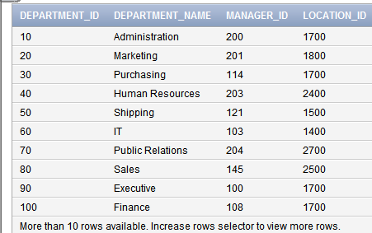
Selecting all rows and columns:
SELECT *
FROM departments;
Notes:
*
07/16/96
*
##

Slide 9
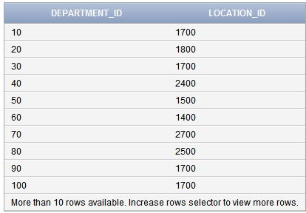
Projection (one of the primitive relational operators): List specific columns
SELECT department_id, location_id
FROM departments;
Notes:
*
07/16/96
*
##

Slide 10
Common Data types
CHAR(n)
  Fixed length alphanumeric string
  Pads unused components with spaces
VARCHAR2(n)
  Variable length alphanumeric string
  Up to n characters
  No padding with spaces

Slide 11
Common data types (continued)…
NUMBER
  Up to 38 digits of precision (total digits before and after decimal point)
  Floating decimal point
NUMBER (p, n)
  Can have up to p digits of precision, n of which are after the decimal point
  Fixed decimal point
  Can hold a number up to 9999.99
  Up to 38 digits of precision

Slide 12
Common data types (continued)…
DATE
  Stored as a number
  Example:
  20150905172500
  (this is 5:25 pm on 9/5/2015)

Slide 13
Column Heading Defaults
Justification:
  Date and character data - Left
  Numeric Data - Right
Default display: Uppercase
You can override column heading with a column alias
Notes:
*
07/16/96
*
##

Slide 14
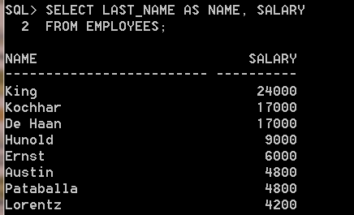
Example:
SELECT last_name AS name, salary
FROM employees;
Column heading
Always CAPITALIZED
Character data
Justified LEFT
Numeric data
Justified RIGHT
Notes:
*
07/16/96
*
##
The optional keyword AS has been used before the last_name column alias.
The result of the query would be the same whether AS is used or not.

Slide 15
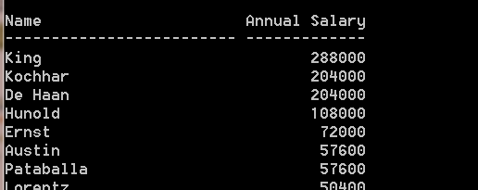
Column Alias: Use double-quotes around case sensitive column names or names with spaces:
SELECT last_name AS “Name”,
salary*12 AS “Annual Salary”
FROM employees;
Notes:
*
07/16/96
*
##
Because Annual Salary contains spaces, it has been enclosed in quotation marks.

Slide 16
Arithmetic Expressions in SELECT clause:
NUMERIC operators:
  + ADD
  - SUBTRACT
  * MULTIPLY
  / DIVIDE
DATE operators:
  + ADD
  - SUBTRACT
Notes:
*
07/16/96
*
##
You may need to modify the way in which data is displayed.
You can perform calculations
You can use arithmetic operators in any clause of a SQL statement except the FROM clause.

Slide 17
Order of operations
Parenthesis
* and / (from left to right)
+ and – (from left to right)
(Note: same as in mathematics)
Note: There is no exponentiation operator.
To raise a number to a power, one would use
the POWER function.
POWER(n,p) is equivalent to n^{p}

Slide 18
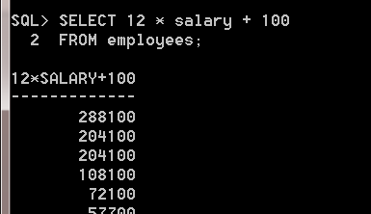
Using an arithmetic operator:
SELECT 12 * salary + 100
FROM employees;
Never leave a column
Heading like this—
Use an alias
Notes:
*
07/16/96
*
##
The salary is multiplied by 12 first and then a one-time bonus of $100 added in.
The multiplication is performed first.
Can use parenthesis to improve clarity of the expression:
(12 * salary) + 100
No change in result.

Slide 19
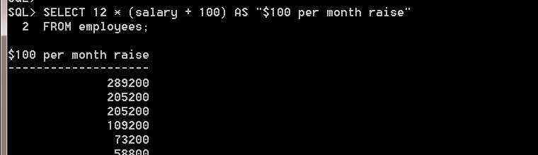
Using Parentheses
SELECT 12 * (salary + 100)
AS “$100 per month raise”
FROM employees;
Notes:
*
07/16/96
*
##
This overrides the rules of precedence by using parentheses.
This calculates the annual salary by giving a $100 raise each month, and then multiplying by 12.
Multiplication is done after the addition.

Slide 20
NULL value
A value that is unavailable, unassigned, unknown, or not applicable
NULL is not the same as zero or a blank space

Slide 21
NULL values in arithmetic expressions cause the whole thing to evaluate to null.
SELECT last_name, commission_pct,
salary + (salary * commission_pct) AS “Total”
FROM employees;
If commission_pct is
Null, the entire expression
Is Null.
Notes:
*
07/16/96
*
##
If any value in an arithmetic expression is null, the result is null.
In the example, KING is not a SALESMAN and his comm is null. Therefore the result of the expression is also null.

Slide 22
To fix this, use NVL (Null Value) function:
SELECT last_name, NVL(commission_pct, 0)
NVL(salary, 0) + NVL(commission_pct, 0)
FROM employees;
Notes:
*
07/16/96
*
##
If any value in an arithmetic expression is null, the result is null.
In the example, KING is not a SALESMAN and his comm is null. Therefore the result of the expression is also null.

Slide 23
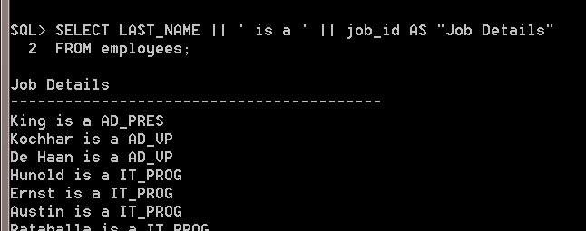
Concatenation operator || (railroad tracks):
SELECT last_name || ‘ is a ‘ || job_id AS “Job Details”
FROM employees;

Slide 24
Character literal
This is any text that is enclosed in single quotes
Ex: ‘Job Title’
Use single quotes for all literals
A literal will be displayed for every row
Only time double quotes are used is for a column alias

Slide 25
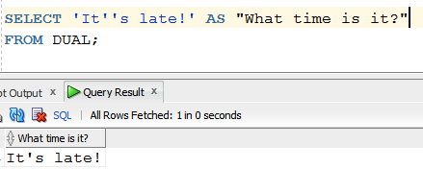
What if the literal contains a quote?
Example: ‘It‘s late’
One way to indicate a quote mark within a quotation is to enter two single quotes
Example: ‘It‘‘s late’

Slide 26
Another way to deal with the quote in a literal: Alternative Quote (q)
q'c text-to-be-quoted c'
c is a single character (called the quote delimiter).
SELECT q'+It’s Late+' FROM dual;
SELECT q'<It’s Late>' FROM dual;

Slide 27
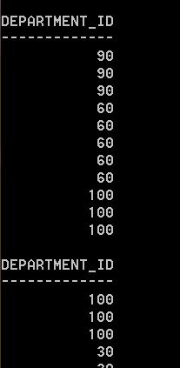
Duplicate rows
The default display of queries is all rows, including duplicate rows.
SELECT department_id
FROM employees;
There are
duplicates
Notes:
*
07/16/96
*
##
Unless you indicate otherwise, the results will be displayed without eliminating duplicate rows.
The example shows all department numbers from the employees table. Notice that some department numbers are repeated.

Slide 28
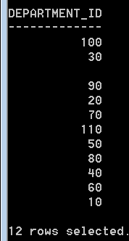
Eliminating Duplicate rows
Use the DISTINCT keyword
SELECT DISTINCT department_id
FROM employees;
No
duplicates
Notes:
*
07/16/96
*
##
Unless you indicate otherwise, the results will be displayed without eliminating duplicate rows.
The example shows all department numbers from the employees table. Notice that some department numbers are repeated.

Slide 29
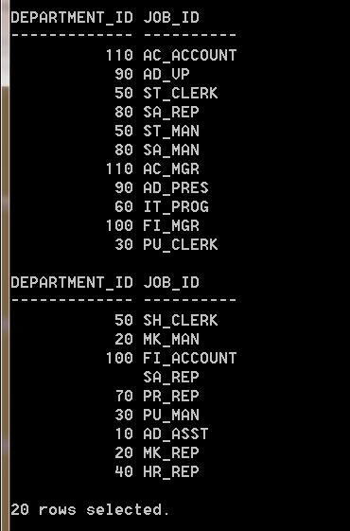
You can specify several columns after the DISTINCT qualifier
SELECT DISTINCT department_id, job_id
FROM employees;
You will get
Distint PAIRS of
(Department_id, job_id)
Example:
ST_CLERK
50 ST_MAN
50 SH_CLERK
Notes:
*
07/16/96
*
##

Slide 30
Problem Set for Chapter 2:
See Chapter 2 Problem Set in D2L

